Slide 1


Bloomington Redevelopment Commission:
TIF Impact Update

Slide 2
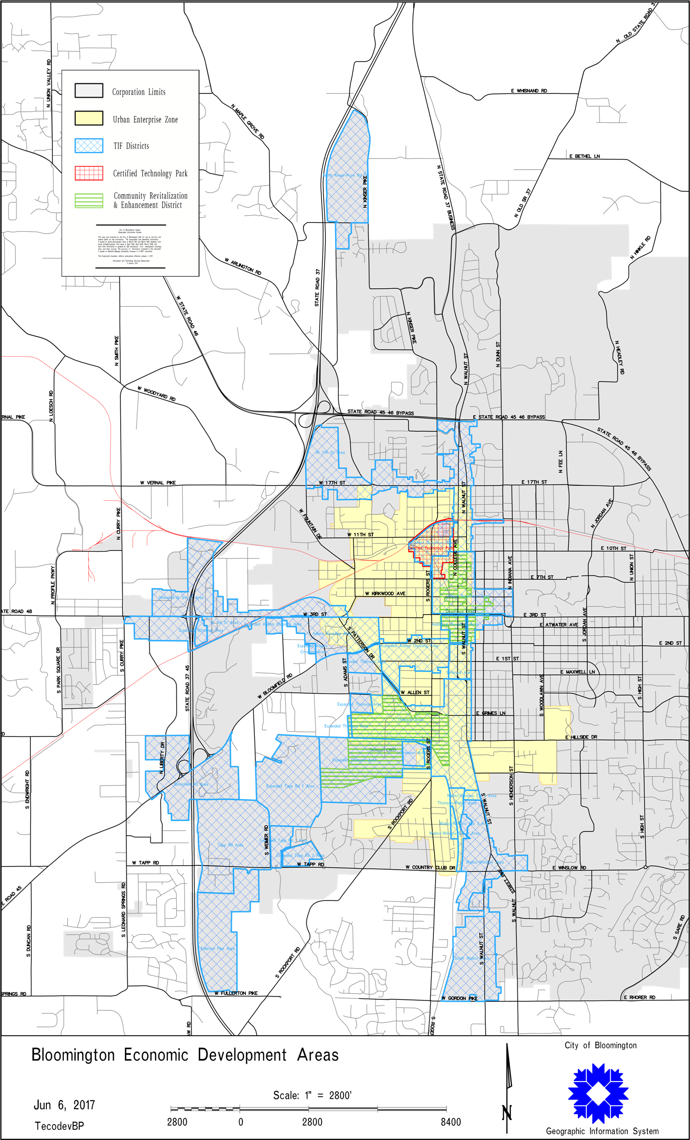
Inside the RDC
Economic Development Area: an allocation area hoping to increase employment opportunities, attract new businesses, or retain or expand business in the area.
Tax Increment Financing (TIF): Growth in assessed value in an allocation area times the taxing district rate will provide revenue for projects benefiting the area.

Slide 3
Why Create a TIF District?
Attract capital investment to the area
Attract new residents to the community
Promotes economic development in an otherwise stagnate area
Allows for redevelopment to be self-funded through assessed value growth
It provides a financing tool for redevelopment
Issuance of debt on TIF revenue is less restrictive and does not require petition or referendum
Notes:
**Reword the last three

Slide 4
Reporting Requirements
Prior to April 1st: Clerk-Treasurer’s Annual Report to the Redevelopment Commission
No Later Than April 15th: Report of Previous Years’ Activities to the Fiscal/Executive Body
Prior to June 15th: Determination of Excess Incremental Assessed Value Pass-Through for the Upcoming Pay Year
Prior to July 1st: Presentation to All Overlapping Taxing Units
  Includes: RDCs budget, long-term plans for the allocation area, and the TIF impact on each of the taxing units
Prior to August 1st: Neutralization of Base Assessed Value for the Upcoming Year

Slide 5
TIF Overview
Base AV
Existing AV at the time TIF is Established
Percentage of what doesn’t meet the Incremental AV classification
Incremental AV
New Construction (+)
New Abatement Roll off (+)
New Destruction (-)
New Appeals (+)
Incremental AV: Goes to RDC to pay Project Costs
New Post Project AV: AV now belongs to all taxing units in the area
Assessed Value ($)
Increase in AV from Economic Development
Base AV: Goes to all Taxing Units in the Area
1 5 10 15 20 25
Years
5
TIF Established
End of TIF

Slide 6
Consolidated TIF Fund
Long Term Plans
Street & Sidewalk Projects
Trades District
Hospital Site Reuse
Bond Payments

Slide 7
North Kinser Allocation Area
Long Term Plans
Cascades Trail

Slide 8
RDC Fund
Long Term Plans
Building maintenance/utilities

Slide 9
AIM Research
During the 2018 AIM Conference we jointly presented with Barnes and Thornburg regarding TIF Impact
To calculate the true TIF impact to overlapping units, we analyzed every parcel in Wayne, Boone, and Jasper county to come up with the most accurate impact report possible
This in depth analysis averaged 100+ hours per county
In an effort to save time and money, for the RDC we have created a process based off our in depth analysis to arrive at an estimation of what we can reasonably assume the circuit breaker impact to be

Slide 10
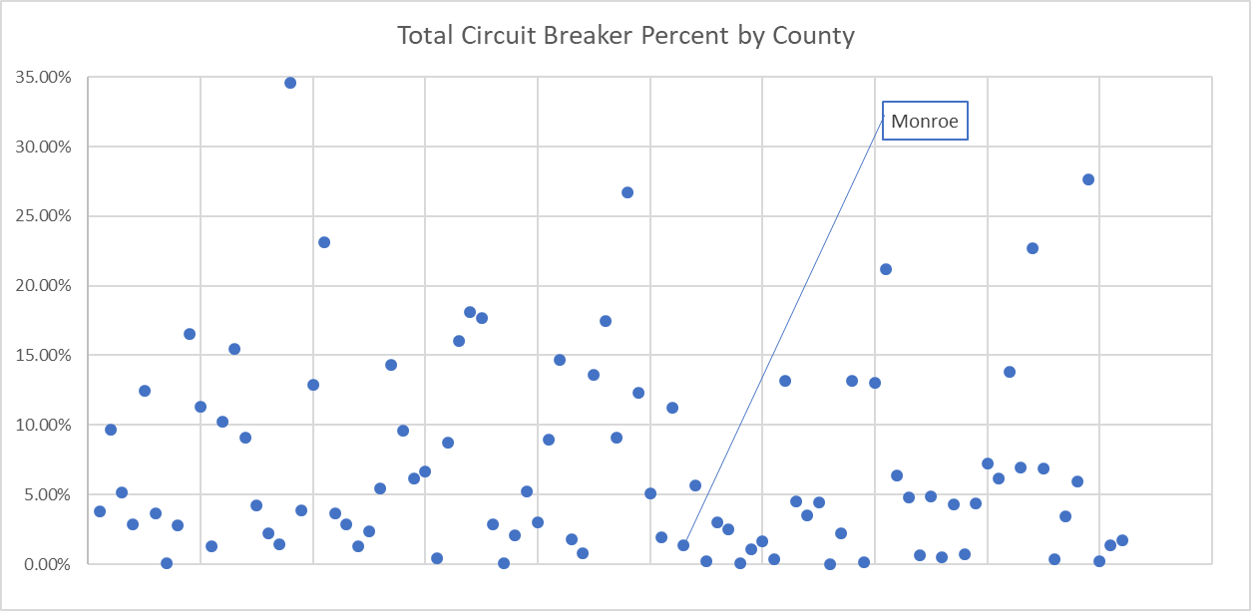
Circuit Breaker Correlation
The level of TIF impact is directly correlated to the circuit breaker environment where the TIF is located
The higher the circuit breaker the higher the impact to overlapping units
Monroe County ranks 75th out of all 92 counties in the State

Slide 11
TIF Impact Chart
We have provided an estimated circuit breaker impact
*Percent of Total Impact = Circuit Breaker Impact of an Individual Unit / Total Impact to All Overlapping Units
**Impact as a Percent of 2018 Budget = Circuit Breaker Impact of an Individual Unit / 2018 Budget of that Individual Unit

Slide 12
TIF Benefits
RDC TIF Margin = $0.82
  TIF Margin is stated in terms of additional money collected per every $1 collected in the RDC
    The TIF Margin is the additional revenue per every $1 collected in the RDC that would be foregone if the RDC did not exist. This revenue would not be collected by the overlapping units.
    $9,784,623 worth of revenue is collected due to the RDC being established (Total collections in 2018 for every allocation area combined)
    Without the RDC the same assessed value would only yield $1,809,596 worth of revenue (2018 Circuit Breaker Impact)
Switchyard Park
Going Solar
Street & Sidewalk Projects
Trades District

Slide 13


Thank you!
Report Presented by Eric Reedy & Matthew Frische

